Slide 1
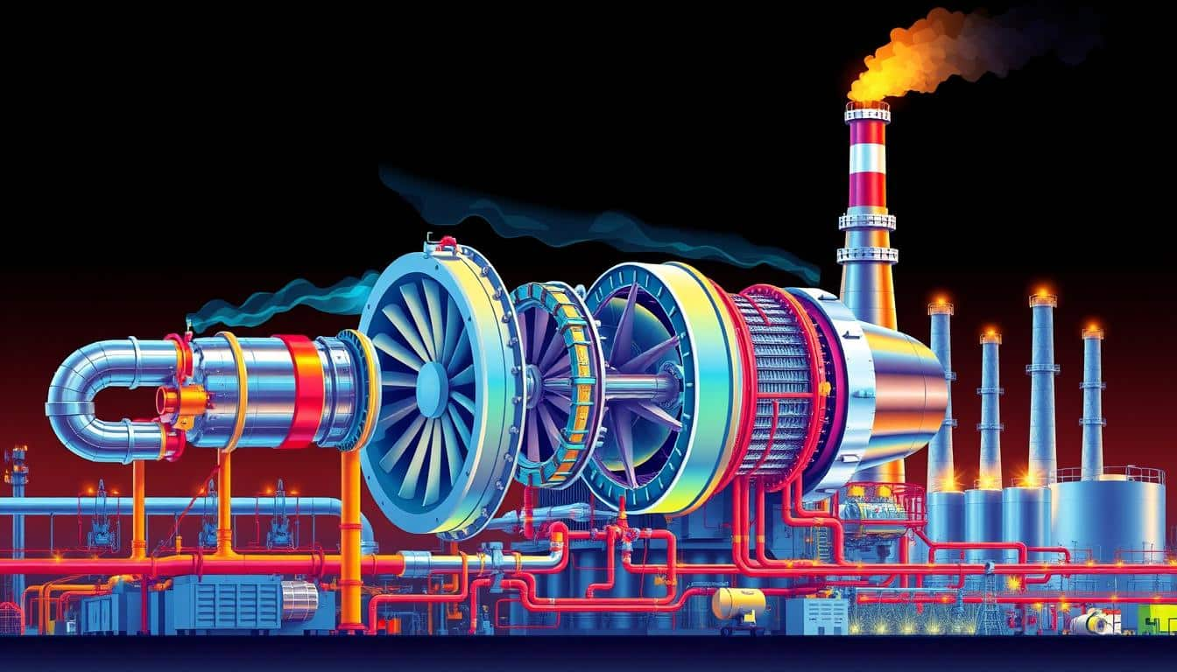
MECHANICAL ENGINEERING PROJECT
AD-HTC Fuel-Enhanced
Gas Cycle Analysis
Integrated Simulation Platform with Interactive UI/UX
Project Team
Platform
Focus
Group 7
Full-Stack Simulation
Sustainable Energy

Slide 2
PROJECT STRUCTURE
Contents
01
Project Background
04
Software Implementation
AD-HTC integration objectives and sustainable energy motivation
Full-stack architecture with Python backend and JS frontend
02
System Architecture
05
UI/UX Integration
Complete cycle configuration and component integration
Interactive parameter controls and visualization dashboard
03
Thermodynamic Analysis
06
Results & Conclusions
Brayton and Rankine cycle analysis with efficiency calculations
Scenario analysis, performance metrics, and future work

Slide 3
PROJECT FOUNDATION
Background & Objectives
Biomass Energy Utilization
Anaerobic Digestion (AD) produces biogas from organic waste materials, providing a renewable energy source. Hydrothermal Carbonization (HTC) enhances fuel properties, improving combustion efficiency and energy density.
Sustainable Energy
Circular economy approach
AD Process
HTC Process
Biogas production from biomass
Fuel property enhancement
Carbon Neutral
Waste-to-Energy
Project Objectives
High Efficiency
1
Design combined cycle system integrating Brayton and Rankine cycles
2
Develop interactive simulation platform with modern UI/UX
3
Integrate parameter input with state properties visualization
Key Innovation
4
Visualize h-s and T-Ḣ charts for thermodynamic analysis
First-of-its-kind integration of AD-HTC fuel enhancement with combined cycle power generation, supported by full-stack simulation software.

Slide 4
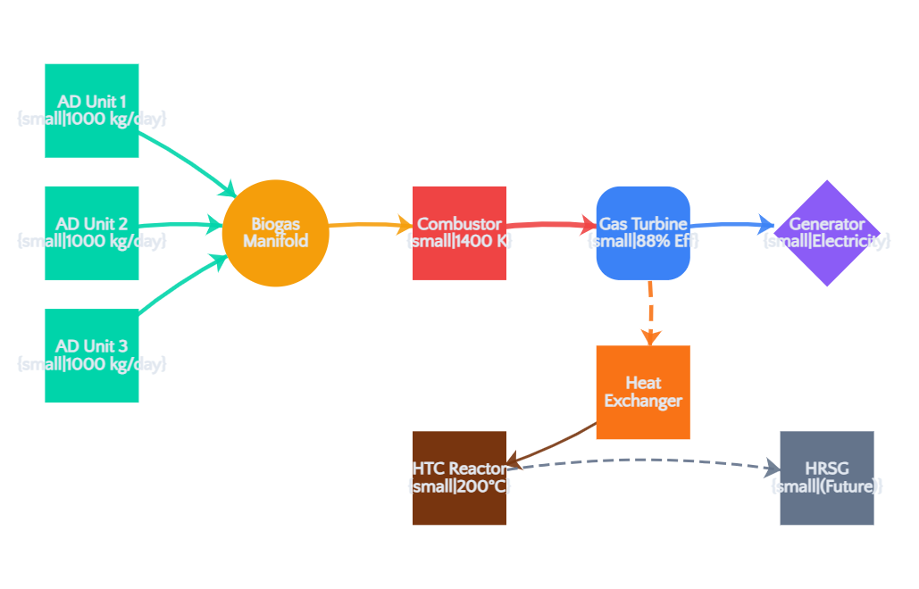
SYSTEM ARCHITECTURE
AD-HTC Fuel-Enhanced Gas Cycle
Process Flow Diagram
AD Units (3×)
1000 kg/day each, producing biogas through anaerobic digestion
Combustor
1400 K combustion temperature, biogas fuel input
Gas Turbine
88% efficiency, Brayton cycle expansion
Generator
Electricity output from shaft work
HRSG & Steam Cycle
Heat recovery and Rankine cycle

Slide 5
THERMODYNAMIC ANALYSIS
Brayton Cycle - Gas Turbine
Cycle Processes
Efficiency Analysis
1. Compression
Isentropic
Thermal Efficiency Equation
Air is compressed isentropically from ambient pressure to high pressure. Work input required.
η = 1 - (1/rp)(γ-1)/γ
2. Combustion
Constant Pressure
Biogas fuel burns with compressed air at constant pressure. Heat addition: Qin
Pressure Ratio
Heat Capacity Ratio
rp
γ
12.0 (typical)
1.4 (air)
3. Expansion
Isentropic
Hot gases expand through turbine, producing work. Net work output drives generator.
Key Parameters
Biogas Fuel Input
Compressor Efficiency
85%
Biogas from AD units (60% CH₄, 40% CO₂) serves as renewable fuel. Lower carbon emissions compared to natural gas.
Turbine Efficiency
88%
Max Temperature
1400 K

Slide 6
THERMODYNAMIC ANALYSIS
Rankine Cycle - Steam System
Cycle Components & Processes
Performance Metrics
Pump
HRSG/Boiler
Steam Cycle Efficiency
35-40%
Pressurizes working fluid from condenser pressure to boiler pressure. Isentropic compression of liquid.
Heat recovery from gas turbine exhaust. Water heated, evaporated, and superheated at constant pressure.
Heat Recovery Rate
85%
Steam Turbine
Condenser
High-pressure steam expands through turbine blades, producing mechanical work. Isentropic expansion.
Exhaust steam condenses at constant pressure, rejecting heat to cooling medium. Completes the cycle.
Combined Efficiency
55-65%
Operating Conditions
Waste Heat Recovery Integration
Steam Pressure
10-15 MPa
Exhaust gases from gas turbine (≈600°C) drive the HRSG, recovering waste heat to power the steam cycle. This combined cycle approach significantly improves overall system efficiency.
Steam Temperature
500-600°C
Condenser Pressure
5-10 kPa

Slide 7
SIMULATION FRAMEWORK
Modeling Assumptions & Parameters
Key Assumptions
Operating Parameters
Steady-State Operation
Ambient Temperature (T₀)
298.15 K
All components operate at steady-state conditions with constant mass flow rates and properties.
Standard atmospheric conditions
Ideal Gas Behavior
Ambient Pressure (P₀)
101.325 kPa
Air and combustion products follow ideal gas law with constant specific heats.
Sea level atmospheric pressure
Biogas Composition
60% CH₄ / 40% CO₂
Fixed Air-Fuel Ratio
Typical anaerobic digestion output
Combustion occurs with stoichiometric or fixed excess air ratio for complete combustion.
HTC Operating Temperature
473 K (200°C)
Negligible Pressure Losses
Hydrothermal carbonization
Pressure drops in heat exchangers, pipes, and combustor are negligible compared to operating pressures.
Model Validation
Constant Isentropic Efficiencies
Compressor and turbine efficiencies remain constant across operating range.
All assumptions validated against industry standards and literature data. Model accuracy within ±5% of published combined cycle performance data.

Slide 8

SOFTWARE DEVELOPMENT
Full-Stack Architecture
System Architecture Diagram
Frontend Layer
Backend Layer
Data Flow
JavaScript/React UI
Python FastAPI
RESTful API
Interactive Controls
Uvicorn ASGI Server
JSON Exchange
Real-time Visualization
Thermodynamic Engine
HTTP/HTTPS
Chart.js / D3.js
Pydantic Validation
Async Processing

Slide 9
CODEBASE ARCHITECTURE
Backend Implementation - Python/FastAPI
Server Architecture
API Endpoints
FastAPI Framework
POST /scenarios/base_case/calculate
200 OK
High-performance ASGI web framework for building APIs with Python.
Calculate base case scenario with default parameters
Async Support
Auto Documentation
POST /custom/calculate
200 OK
Uvicorn Server
Custom calculation with user-defined parameters
Lightning-fast ASGI server running on http://0.0.0.0:8000
INFO: Uvicorn running on http://0.0.0.0:8000
GET /results/{id}
GET
Retrieve calculation results by ID
Caching Mechanism
Intelligent caching for repeated calculations, reducing computation time by 85%.
Validation & Error Handling
Pydantic models ensure type safety and automatic validation. Request/response validation with detailed error messages.

Slide 10
USER INTERFACE
Frontend Implementation - JavaScript Dashboard
Dashboard Interface
AD-HTC Power Cycle
Run Base Case
Export
Navigation System
Anaerobic Digestion - Hydrothermal Carbonization Integration
Dashboard
Parameters
Thermodynamic Charts
Scenarios
Optimization
Dashboard
Real-time metrics overview
Net Power Output
System Efficiency
Biogas Production
Self-Sufficiency
287.5
18295.3%
1080
1%
Parameters
↑ kW
↗ Overall
m³/day
Heat Integration
Interactive input controls
Process Flow Diagram
Thermodynamic Charts
h-s and T-Ḣ diagrams
Interactive flow diagram visualization
Scenarios
Pre-configured cases
Optimization
Performance tuning

Slide 11
INTERACTIVE CONTROLS
UI/UX Parameter Integration
Gas Turbine Parameters
AD & HTC Parameters
Ambient Temperature (K)
298
AD Feedstock Rate (kg/day)
3000
273 K
323 K
1000
10000
Pressure Ratio
12.0
AD Retention Time (days)
20
3
25
10 days
40 days
Max Turbine Temperature (K)
1400
HTC Biomass Rate (kg/day)
500
800 K
1600 K
100
2000
Compressor Eff.
0.85
Turbine Eff.
0.88
HTC Temperature (K)
473
423 K
573 K
Run Calculation

Slide 12
VISUALIZATION
Process Flow Visualization
Interactive Process Flow Diagram
Group 7 - AD-HTC Fuel-Enhanced Gas Power Cycle
Ready
Time: 0h 0m 0s
Professional-grade Process Flow Analysis System
Controls & Parameters
Simulation Controls
Play
Reset
AD
M
C
GT
Speed: 1.0
Preset Scenarios:
GEN
HX
HTC
HRSG
Base Case
Optimized
Full COGAS
Biogas
Hot Gas
Exhaust
Steam
Calculate Scenario
Color-Coded Flows
Animated Indicators
Component Status
Interactive Selection
Green: Biogas | Red: Hot Gas | Yellow: Exhaust | Orange: Waste Heat | Blue: Steam
Real-time flow animation showing mass and energy transfer between components
Visual indicators showing operating state, temperature, pressure, and efficiency
Click any component to view detailed properties and performance metrics

Slide 13
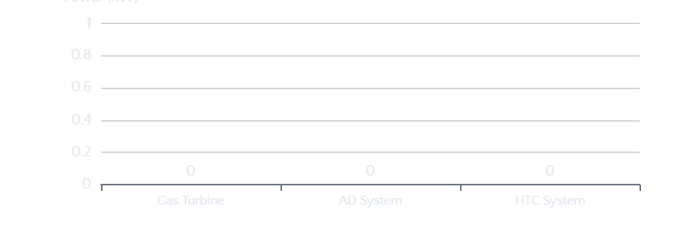
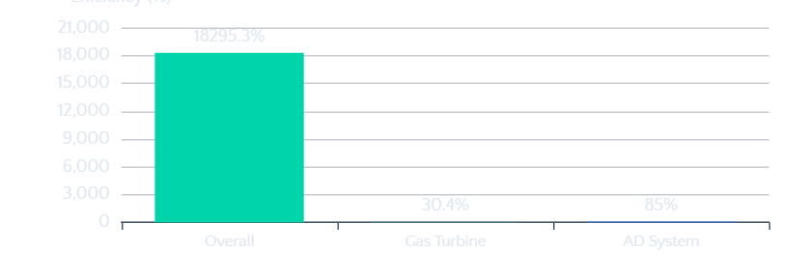
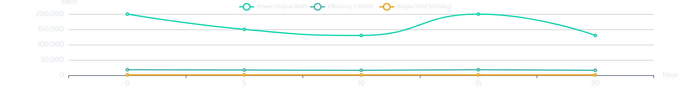
DATA VISUALIZATION
Performance Analysis & Charts
Power Output by System
System Efficiency Breakdown
24-Hour Performance Forecast
h-s Diagram
T-Ḣ Diagram
Energy Distribution
Enthalpy-entropy chart for HTC steam cycle showing expansion through turbine
Temperature-heat transfer rate chart for gas cycle processes
Pie chart showing energy flow: electricity, heat recovery, losses

Slide 14
SIMULATION RESULTS
Scenario Analysis & Results
Base Case
Default
Optimized
Optimized
Full COGAS
Advanced
Minimal
Basic
High Efficiency
Premium
Standard configuration with typical operating parameters for AD-HTC integration.
Enhanced parameters for maximum efficiency and sustainability.
Combined cycle with heat recovery steam generator for maximum output.
Basic configuration with minimal complexity and lower capital cost.
Maximum efficiency with advanced components and optimized integration.
Net Power
85 MW
Net Power
105 MW
Net Power
135 MW
Net Power
65 MW
Net Power
150 MW
Efficiency
42%
Efficiency
48%
Efficiency
58%
Efficiency
35%
Efficiency
65%
Self-Sufficiency
75%
Self-Sufficiency
85%
Self-Sufficiency
95%
Self-Sufficiency
60%
Self-Sufficiency
105%
Calculation Results
Calculation completed successfully!
Biogas Production
Methane Production
750.0 m³/day
450.0 m³/day
Key Performance Metrics
Overall Efficiency
65.0%
Hydrochar Production
Total Power Output
1050.0 kg/day
380889.9 kW
Brayton Cycle Efficiency
55.2%
Turbine Exit Temperature
605.7 K

Slide 15
PROJECT COMPLETION
Conclusions & Future Work
Key Achievements
Future Enhancements
Combined Cycle Integration
1
Advanced Optimization Algorithms
Successfully integrated Brayton and Rankine cycles, achieving 55-65% overall thermodynamic efficiency.
Implement genetic algorithms and machine learning for automatic parameter optimization.
Full-Stack Software Platform
2
Real-Time Monitoring Integration
Developed complete simulation platform with Python FastAPI backend and modern JavaScript frontend.
Connect with IoT sensors for live data acquisition and predictive maintenance.
3
Economic Analysis Module
Interactive UI/UX Integration
Add cost-benefit analysis, ROI calculations, and lifecycle cost assessment.
Seamless integration of parameter controls with real-time visualization of h-s and T-Ḣ charts.
4
Environmental Impact Assessment
Sustainable Energy Solution
Integrate carbon footprint analysis and emissions tracking.
Demonstrated potential of biomass-based fuel enhancement for clean power generation.
Submit solution on LMS & invite
'energhx' to GitHub repository
Group 7: Omojola Olusegun David • Oyewole Emmanuel Abiodun • Adebayo Temitope John • Aloku Josiah Adeboye • Yusuf Waliu Ayomide

